Slide 1
Java Map Reduce API’s and Counters

Slide 2
Difference
Mapper and Reducer in the old API are Interfaces, while in the new API, they are abstract classes.
Package for old API – org.apache.hadoop.mapred
Package for new API – org.apache.hadoop.mapreduce
Context replaces JobConf, OutputCollector, and Reporter from old API.
JobClient in old API, Job class in new API.
In old API, files from mapper and reducer are named as part-nnnnn, while in new API they are named as part-m-nnnnn, and part-r-nnnnn.
In old API, values to reducer were passed as java.lang.iterator, while in new API, they are passed as java.lang.iterable.

Slide 3
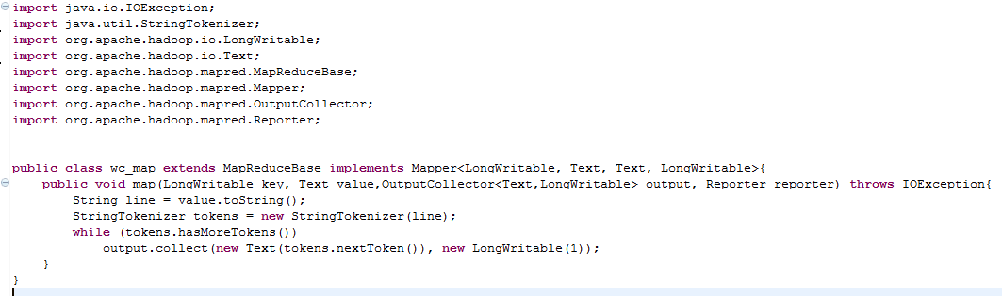
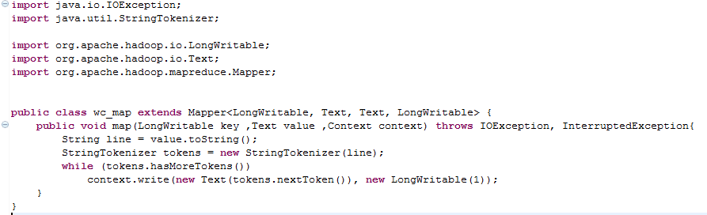
Difference in mapper class

Slide 4
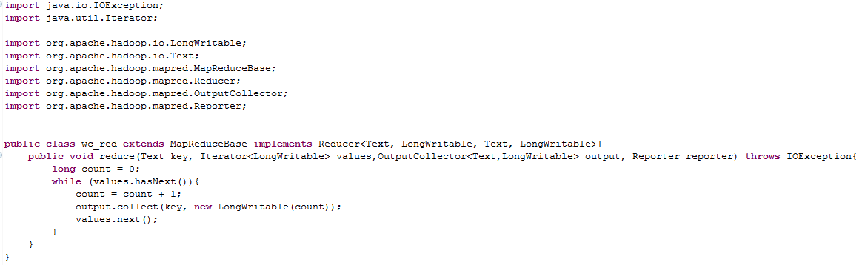
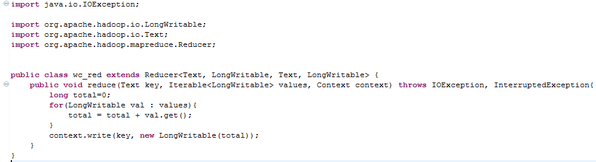
Difference in reducer class.

Slide 5
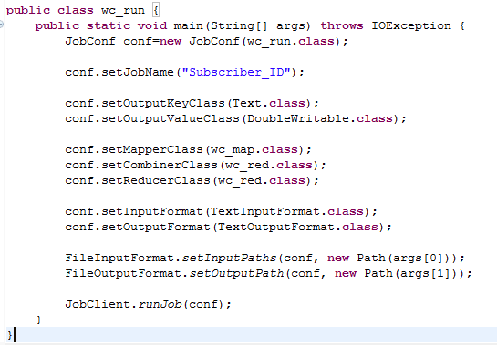
Difference in runner class
Runner class of old API

Slide 6
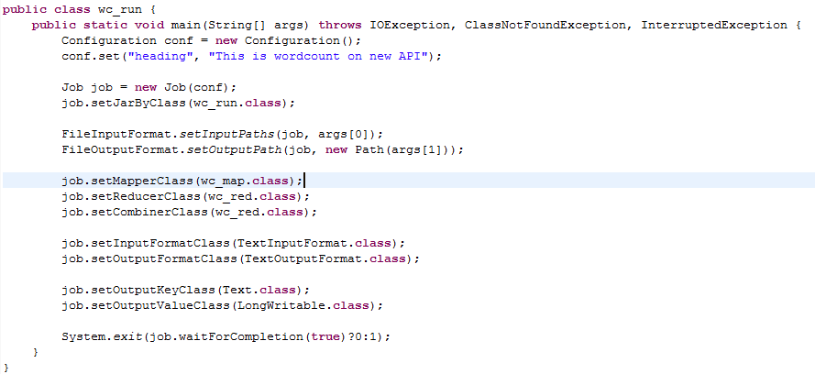
Runner class cont.
Runner class of new API

Slide 7
Counters
Lightweight devices for bookkeeping within MapReduce programs. Tasks increment counters that are aggregated and added to the information about the completed job.
There are many Built-in counters divided into many groups. We can also define User Defined Counters .
All Counters are either Task Counters or Job Counters.
Task Counters -Task counters gather information about tasks over the course of their execution, and the results are aggregated over all the tasks in a job. Task counters are sent in full every time, rather than sending the counts since the last transmission, since this guards against errors due to lost messages
Job Counters - They maintained by the jobtracker (or application master in YARN), so they don’t need to be sent across the network, unlike all other counters, including user-defined ones.

Slide 8
User Defined Counters
Counters are defined by a Java enum, which serves to group related counters. A job may define an arbitrary number of enums, each with an arbitrary number of fields. The name of the enum is the group name, and the enum’s fields are the counter names.
They may be defined in two ways :
using an enum;
dynamic counters;

Slide 9
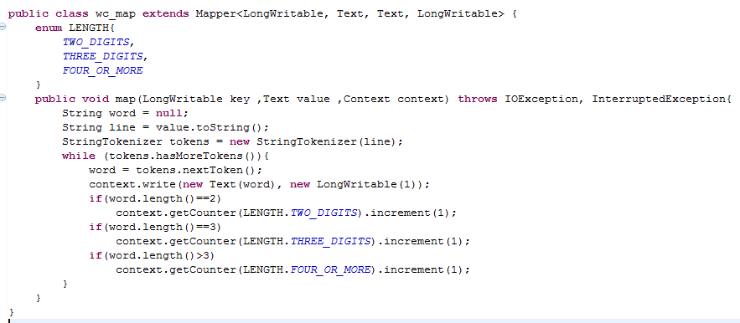

Counters using an enum

Slide 10
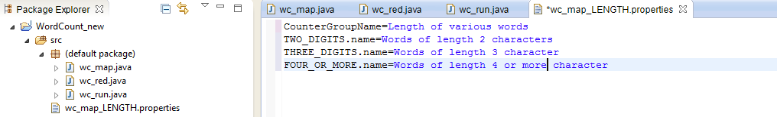

Changing Appearance of counter names
Create a properties file named after the enum, using an underscore as a separator for nested classes.

Slide 11
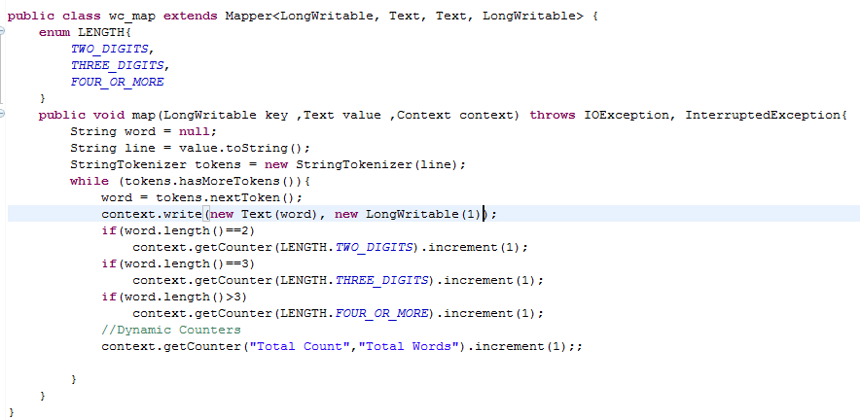
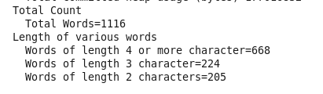
Dynamic Counters
To create counters at run time( using enum counters are created at compile time)

Slide 12
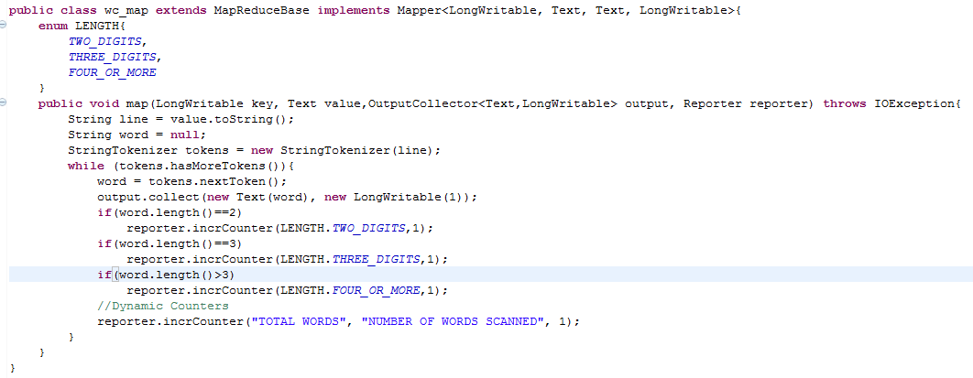
Counters with older API

Slide 13
EduPristine 702, Raaj Chambers, Old Nagardas Road, Andheri (E), Mumbai-400 069. INDIA www.edupristine.com Ph. +91 22 3215 6191

